Slide 1
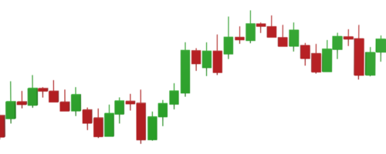
Revolutionizing Stock Market Intelligence: A Deep Dive into Machine Learning for IT Sector Price Predictions
Final Year Project CSE (2020-2024)
By: Mentor:
Parth Mishra Mr. Gaurav Parashar
Vaibhav Chaudhary
Ishant Sehgal

Slide 2
Introduction
The annual number of fluctuations and fluctuations in stock prices is projected to continue rising, with heightened market integration and technological advancements contributing to increased trading volumes and market complexity.
Machine learning has emerged as a powerful tool in stock price prediction, leveraging algorithms to analyze vast amounts of financial data and identify patterns or trends that may indicate future price movements.
By employing machine learning-based prediction models, investors and financial institutions can enhance their decision-making processes, mitigate risks, and capitalize on investment opportunities in the dynamic stock market environment.

Slide 3
Problem Description
Developing an accurate stock price prediction model is essential for investors and financial institutions.
The challenge involves analyzing historical data, identifying key factors, and building a robust model that can adapt to changing market conditions.
Explore Deep Learning Models and Overcome Challenges of Existing Research

Slide 4
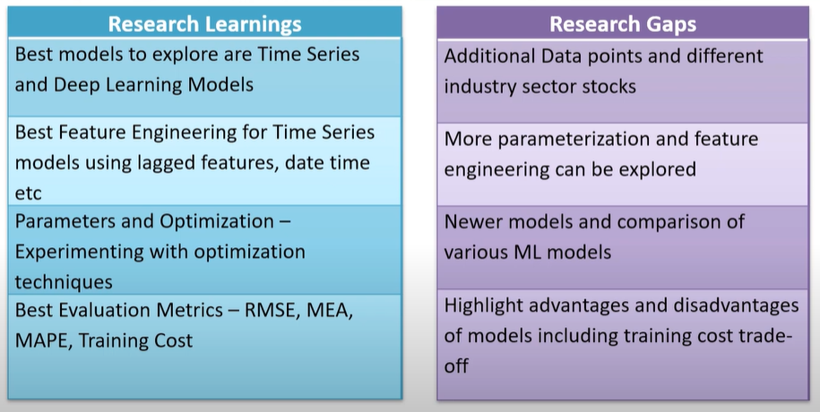
Research Learnings and Gaps

Slide 5
Technologies Used
Python
Sklearn
Numpy
Pandas
Matplotlib
Deep Learning Frameworks

Slide 6
Dataset
The Dataset is taken from Yahoo Finance data since 2014, including stock prices, trading volumes, market indices, and other financial indicators.

Slide 7
Date: This attribute represents the date of the financial data point.
Open: The opening price of the financial instrument on a particular trading day.
High: The highest price of the financial instrument during the trading day
Low: The lowest price of the financial instrument during the trading day.
Close: The closing price of the financial instrument on the trading day.
Adjusted Close: The closing price adjusted for dividends, stock splits, and other corporate actions.
Volume: The number of shares or contracts traded during the trading day.
Dividends: Any dividends paid out by the company during the trading period.
Symbol: The ticker symbol or identifier of the financial instrument.
Currency: The currency in which the financial instrument is traded.
Market Cap: The market capitalization of the company, calculated by multiplying the current stock price by the total number of outstanding shares.
Beta: A measure of a stock's volatility in relation to the overall market.
Dataset Description of Attributes

Slide 8
Algorithms to be used
Long short-term memory networks
Autoregressive integrated moving average
Prophet

Slide 9
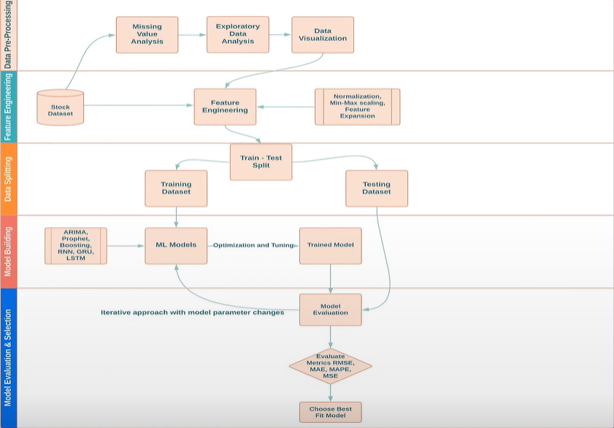
Methodology

Slide 10
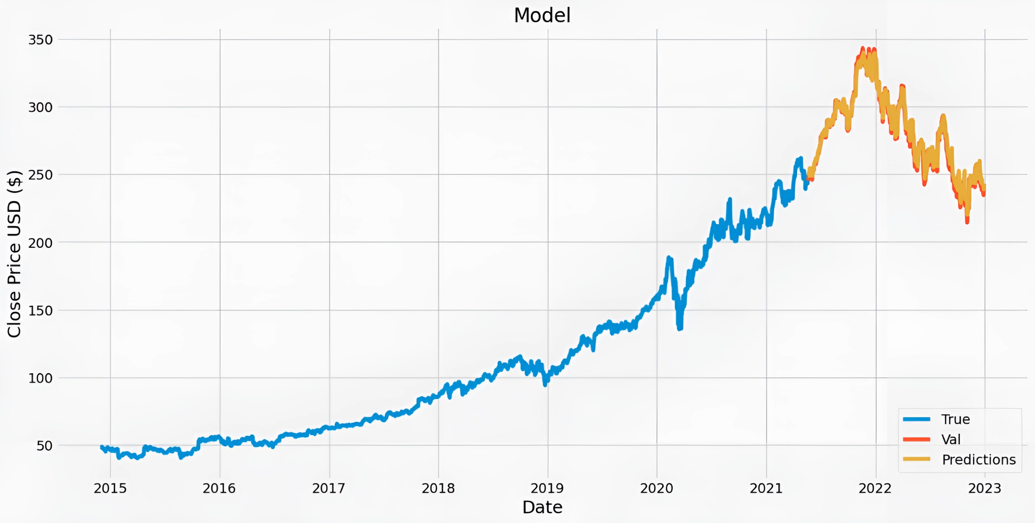
LSTM

Slide 11
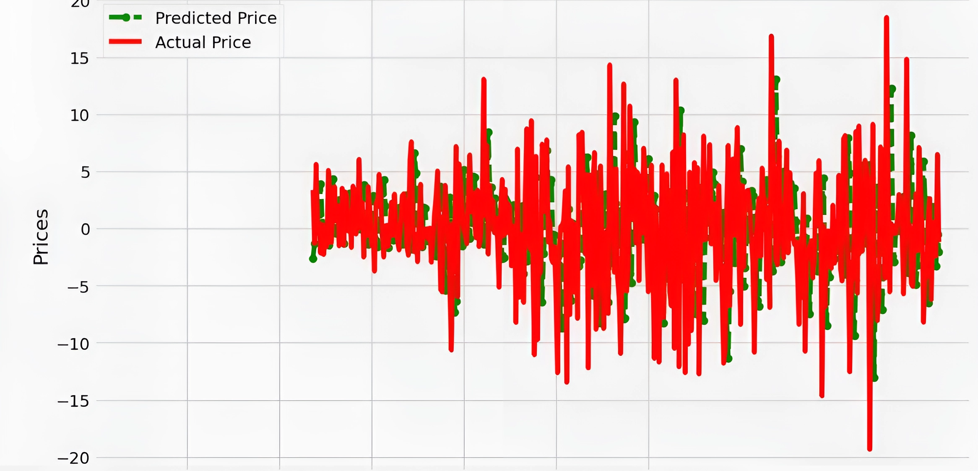
ARIMA

Slide 12
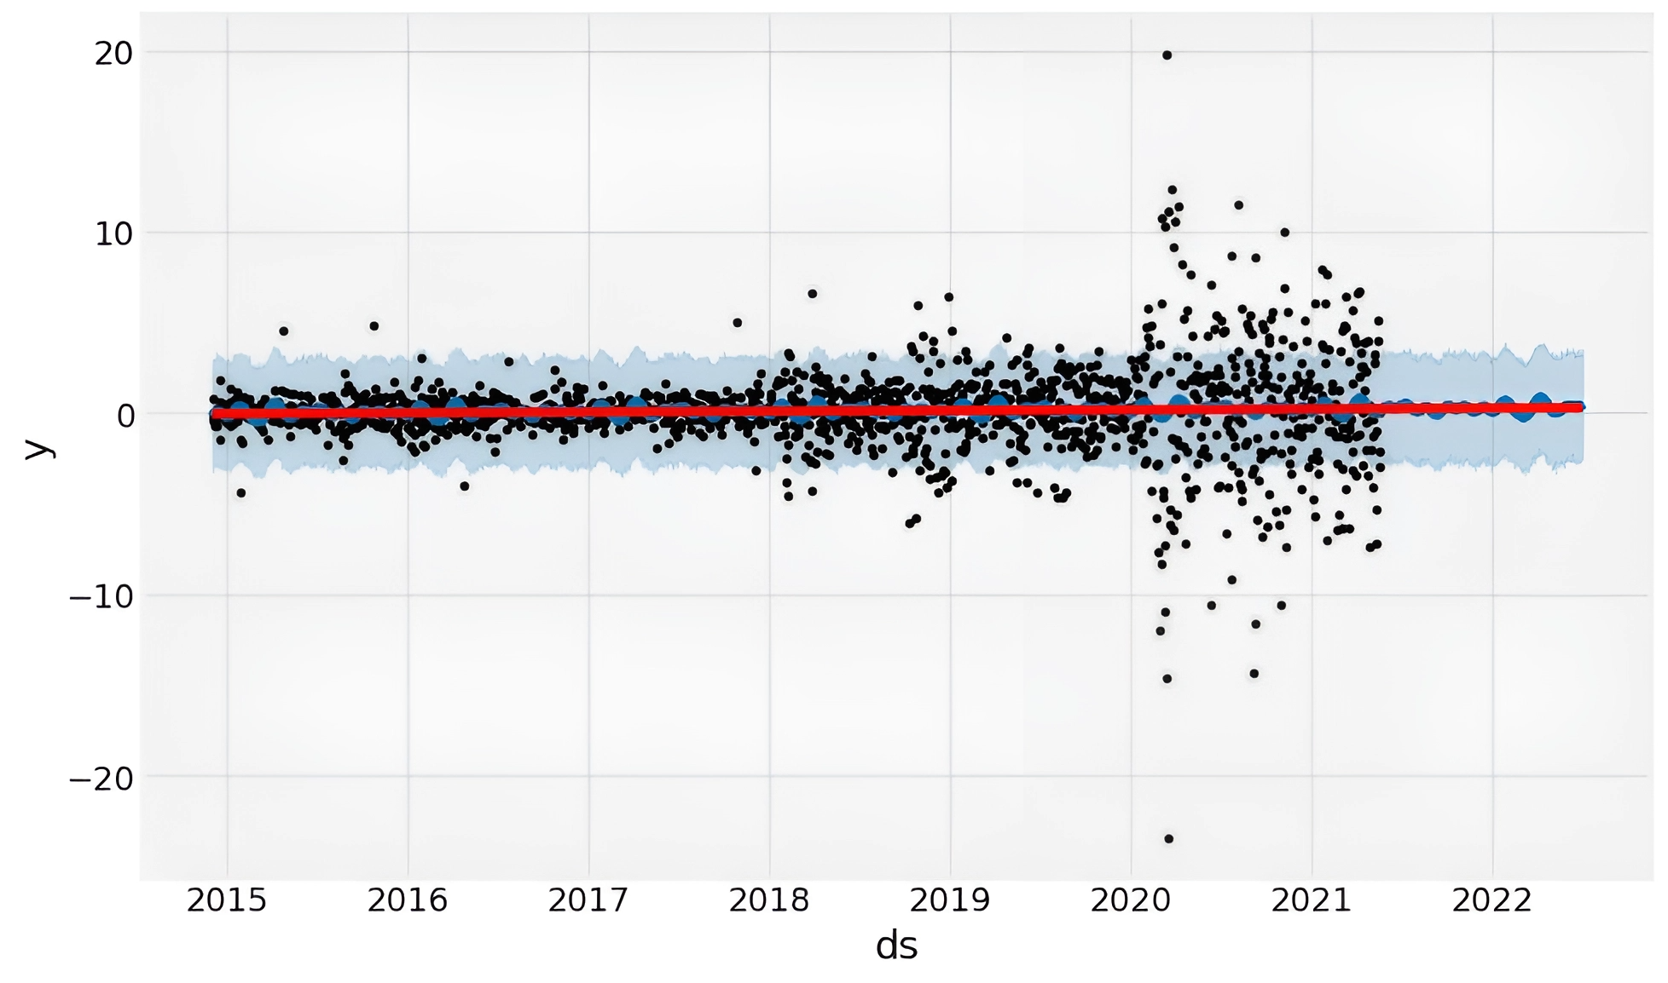
Prophet

Slide 13
Table Of RMSE
MODEL | RMSE
LSTM | 1.204
ARIMA | 6.615
Prophet | 4.527

Slide 14
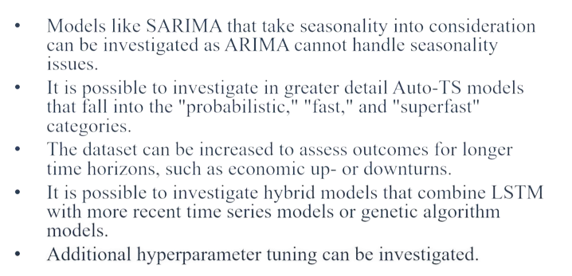
Future Recommendations

Slide 15
Thank you.!

